Slide 1
WALL BUILDING
ROBOT
KOKAN GYANPETH COLLEGE OF ENGINEERING
KARJAT
Team Members:
Prasad Borole (B.E. Computer Engineering)
Pallavi Jain (B.E. Computer Engineering)
Mukeshkumar Choudhary (B.E. Computer Engineering)

Slide 2
Problem Statement
The project is to program the firebird as a prototypic model for building walls and other construction process in future.
This involves detecting the position for wall building and ultimately building the wall.

Slide 3
Project Objective
Automation of the wall building process
Reduction of human efforts
Time efficiency
Process accuracy

Slide 4
Task Specification
Image Capturing
White strip detection
Co-ordinates processed and fed to the robot via ZigBee
Pick and place operation

Slide 5
Working Model
Co-ordinates communicated via ZigBee
Processed co-ordinates fed
Ceiling Camera
Computer System
Robot

Slide 6
Project Plan
The plan used was
Implement the tasks in modules.
The module then tested.
Integrated with the original code and tested.
Also two sub-teams worked upon the image processing part and robot movement in parallel .

Slide 7
Work Division
TEAM MEMBER | WORK CONTRIBUTED
PRASAD BOROLE | MATLAB coding, Programming the FIREBIRD and assembling the robotic arm
PALLAVI JAIN | MATLAB coding, assembling the robotic arm and documentation
MUKESHKUMAR CHOUDHARY | Programming the FIREBIRD and assembling the robotic arm

Slide 8

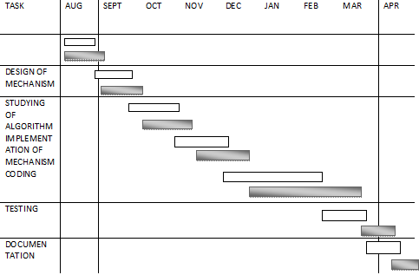
Gantt Chart

Slide 9
Flow Diagram
start
Camera detects the white strip present on the arena
and passes it to Matlab
Matlab processes the image and gives coordinates to the robot i.e.(x,y)
Robot picks up the brick and places at the given coordinates
Camera gives next coordinates i.e.(x+1,y+1)
Robot picks up the brick and goes to the co-ordinates provided to it, places the brick and comes back to its original position.
End of strip?
no
yes
stop

Slide 10
Working
The project works as follows..

Slide 11
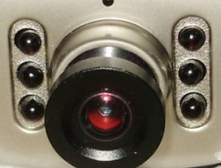
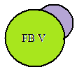

Slide 12
Capturing Image
Passing image for image processing
Matlab Processing
Passing Coordinates

Slide 14
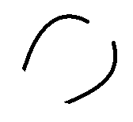

Slide 16
Innovation and Challenges
The communication between the robot and the Matlab code using zigbee.
Feeding proper coordinates from the camera to the
robot
Robot accurately keeping the bricks on the given coordinates
Designing a robotic arm for proper pick and place mechanism.
Maintaining robot efficiency

Slide 17
Task Completed
Co-ordinate detection done successfully
Problem Faced:
Didn’t know how to calculate the co-ordinate of the strip with the help of centroid. Some methods resulted in calculation of many centroids due to non-uniformity in lighting effects and noise.
Solution:
Generated a thresholding code in order to suppress noise and lighting effect so that centroid method could work good.

Slide 18
Task Completed (Contd..)
Placing the brick correctly
Problem Faced:
Maintaining steadiness of the gripper due to weight of servo motor.
Solution:
We placed a weight on the other side of the gripper that balanced the weight of the servo to keep the gripper steady.

Slide 19
Reusability Features
Every line of code is well commented.
Each complex function is well explained in the code.
Each action is implemented as function. So these functions can be reused.
Each and every problem encountered is well documented so that any one can extend the functionality.

Slide 20
Future Enhancement
In case if the wall happens to fall, the robot might pick up the bricks and start building again.
The height of the wall can be considerably high.
Instead of the ceiling camera, camera can be mounted on the robot itself.

Slide 21
Conclusion
Project Conclusion:
Our system is efficient for building wall at the desired location without human interaction.
Our system will provide an affordable and reliable option to users.
Can be used as a base for many other sophisticated and commercialized projects.
On a personal level:
The journey through developing and implementing this project helped us in many ways:
Because of this project, we worked on embedded platform for the first time.
A new concept of wireless communication i.e. Zigbee was brought to light while implementing this project.

Slide 22


